Slide 1
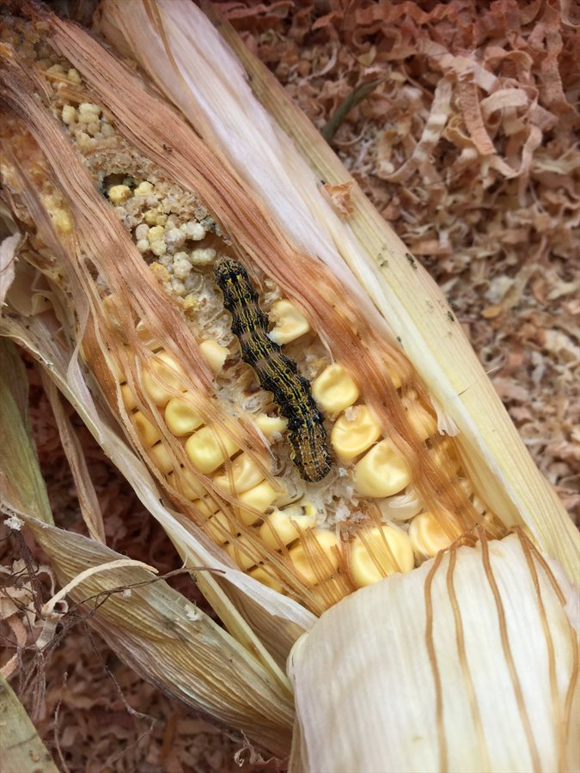
Helicoverpa
Oct 2021
Gabriela Montejo-Kovacevich

Slide 2
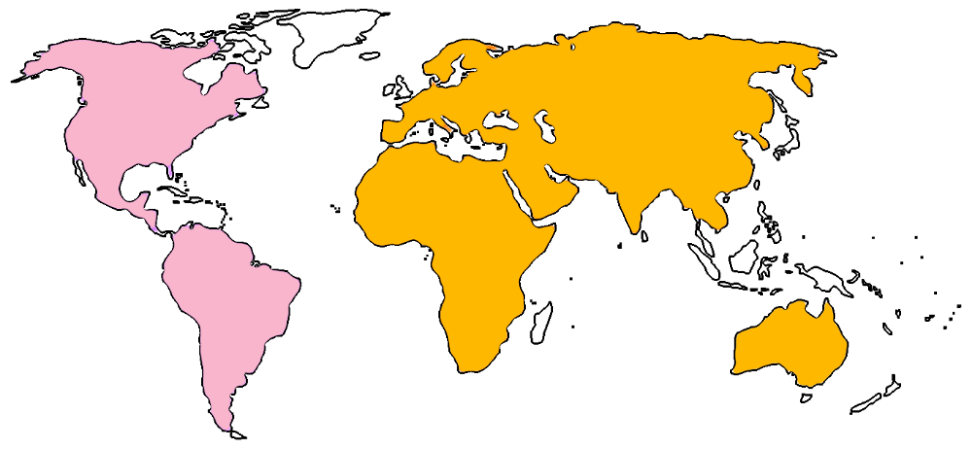
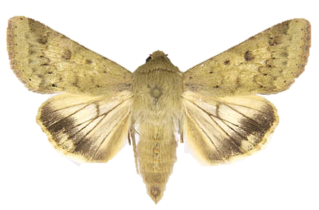
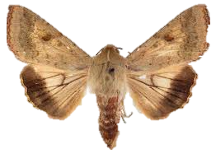


Helicoverpa invasion genomics
2012
Pest outbreaks 2013-2018 led to yield losses of billions USD in Brazil
hybridisation
Pesticide resistance
Insecticide resistance genes*
Feeds on >300 crops
x10 Ne
Ability to feed on more crops?
Bt resistance?
*Valencia-Montoya et al. (2020) MBE
Helicoverpa zea
Helicoverpa armigera

Slide 3
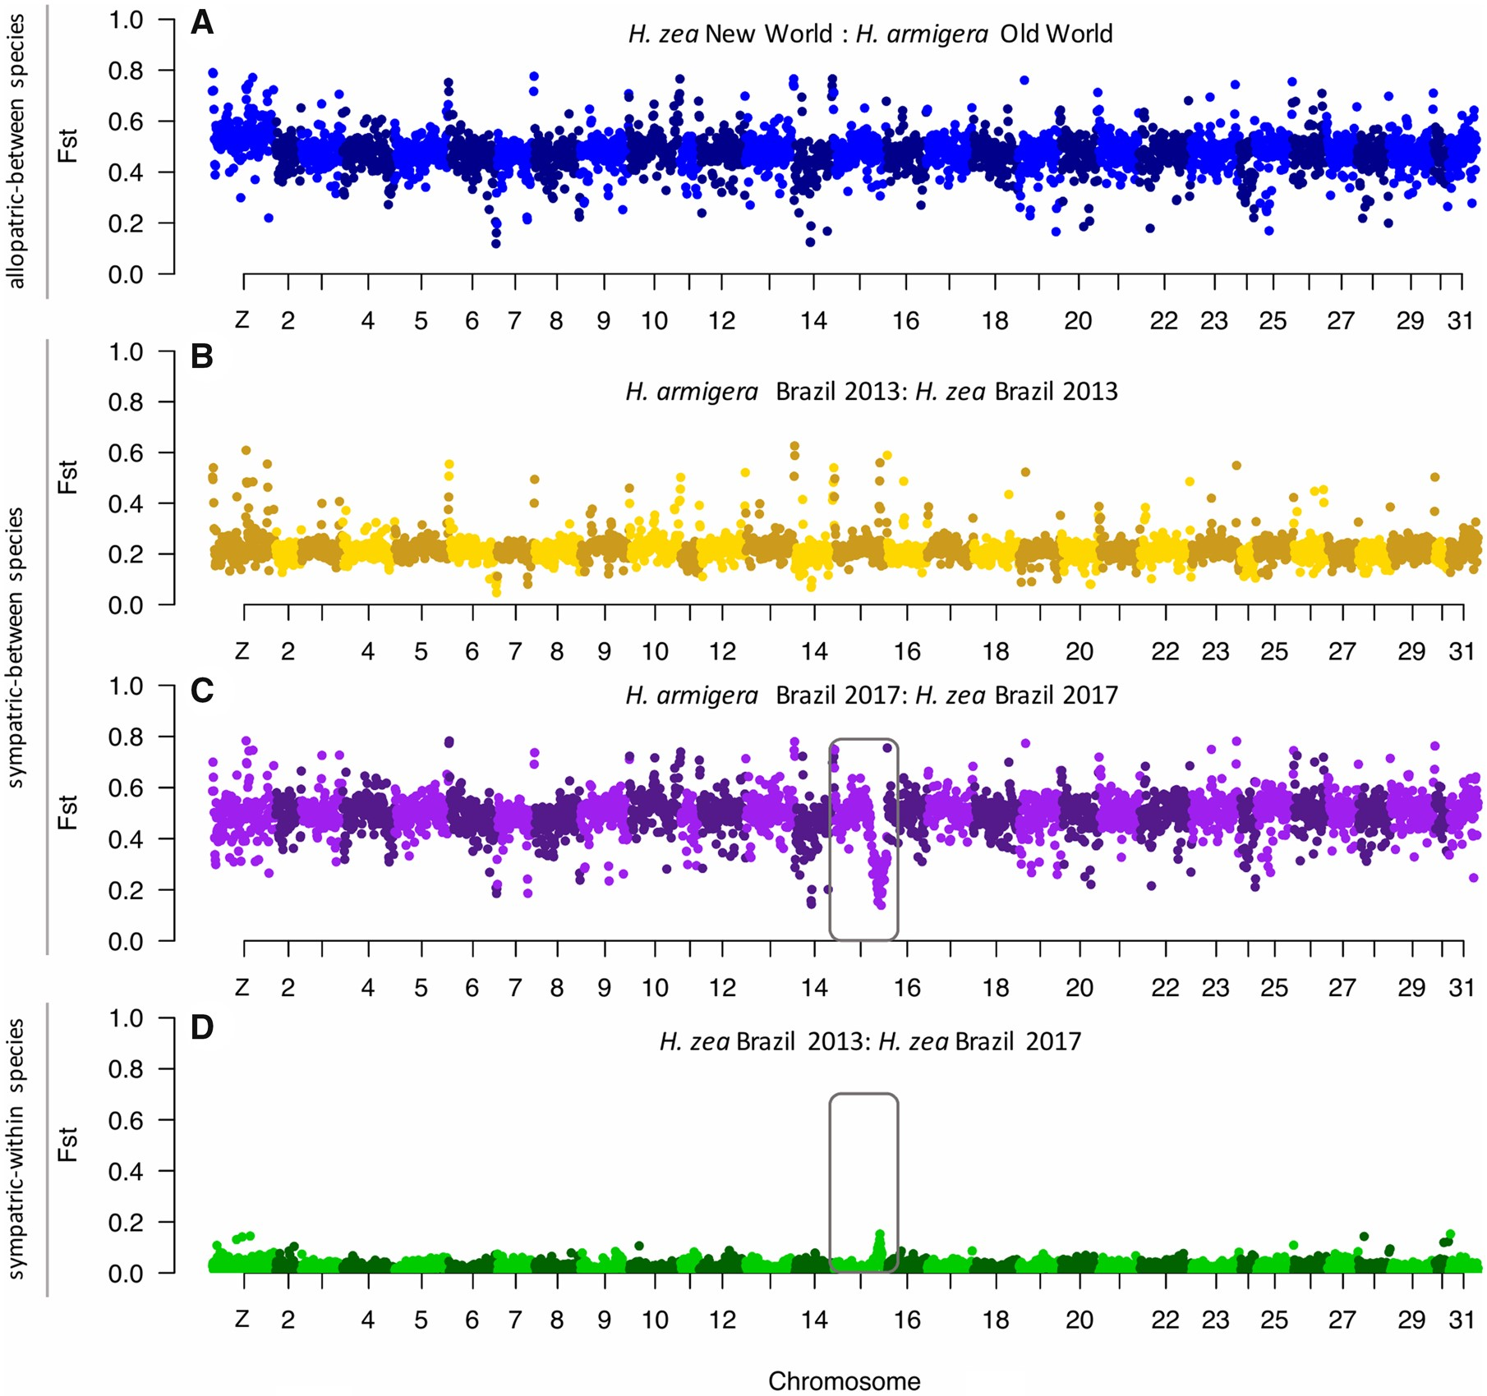
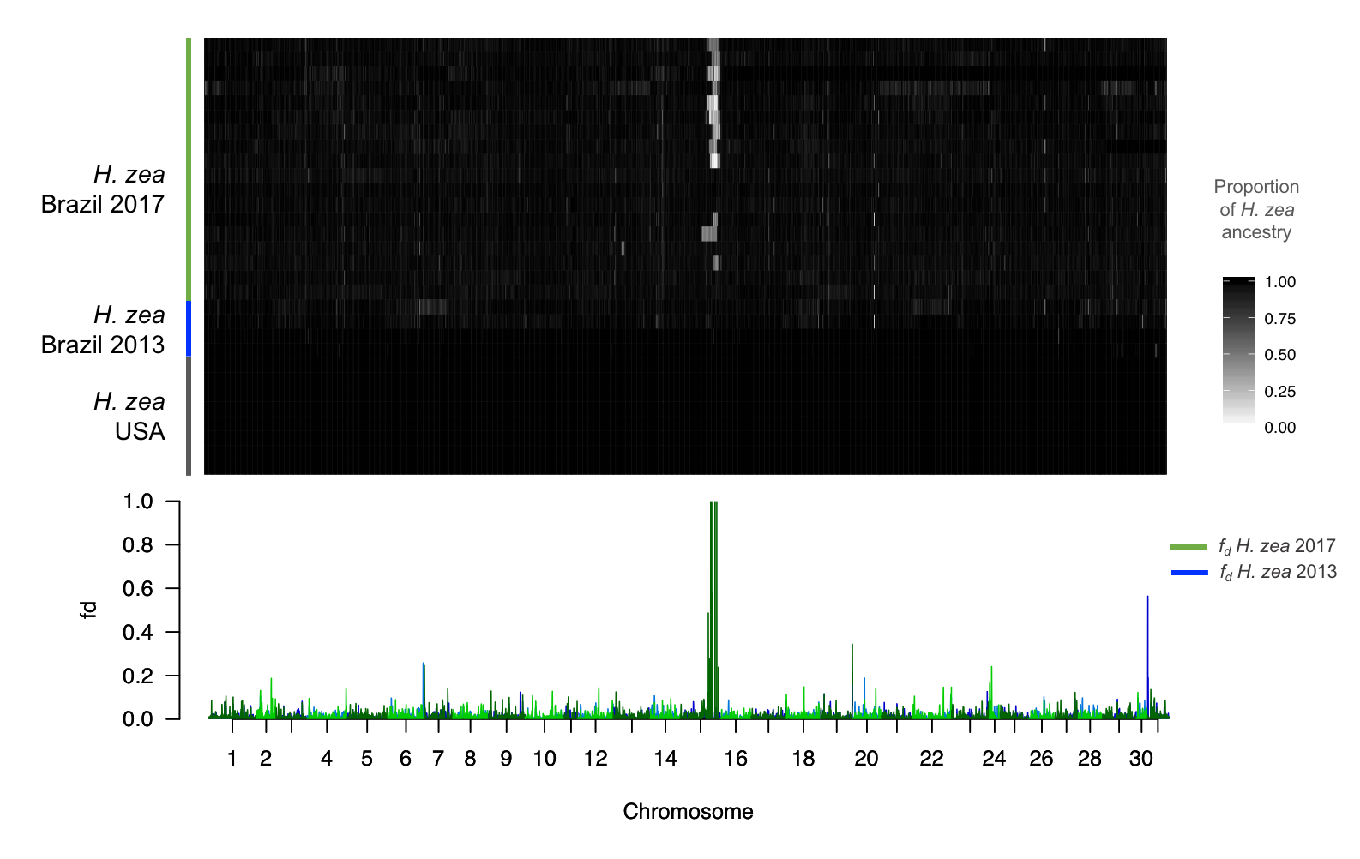
Wendy Valencia-Montoya et al. (2020) MBE
Helicoverpa zea

Slide 4
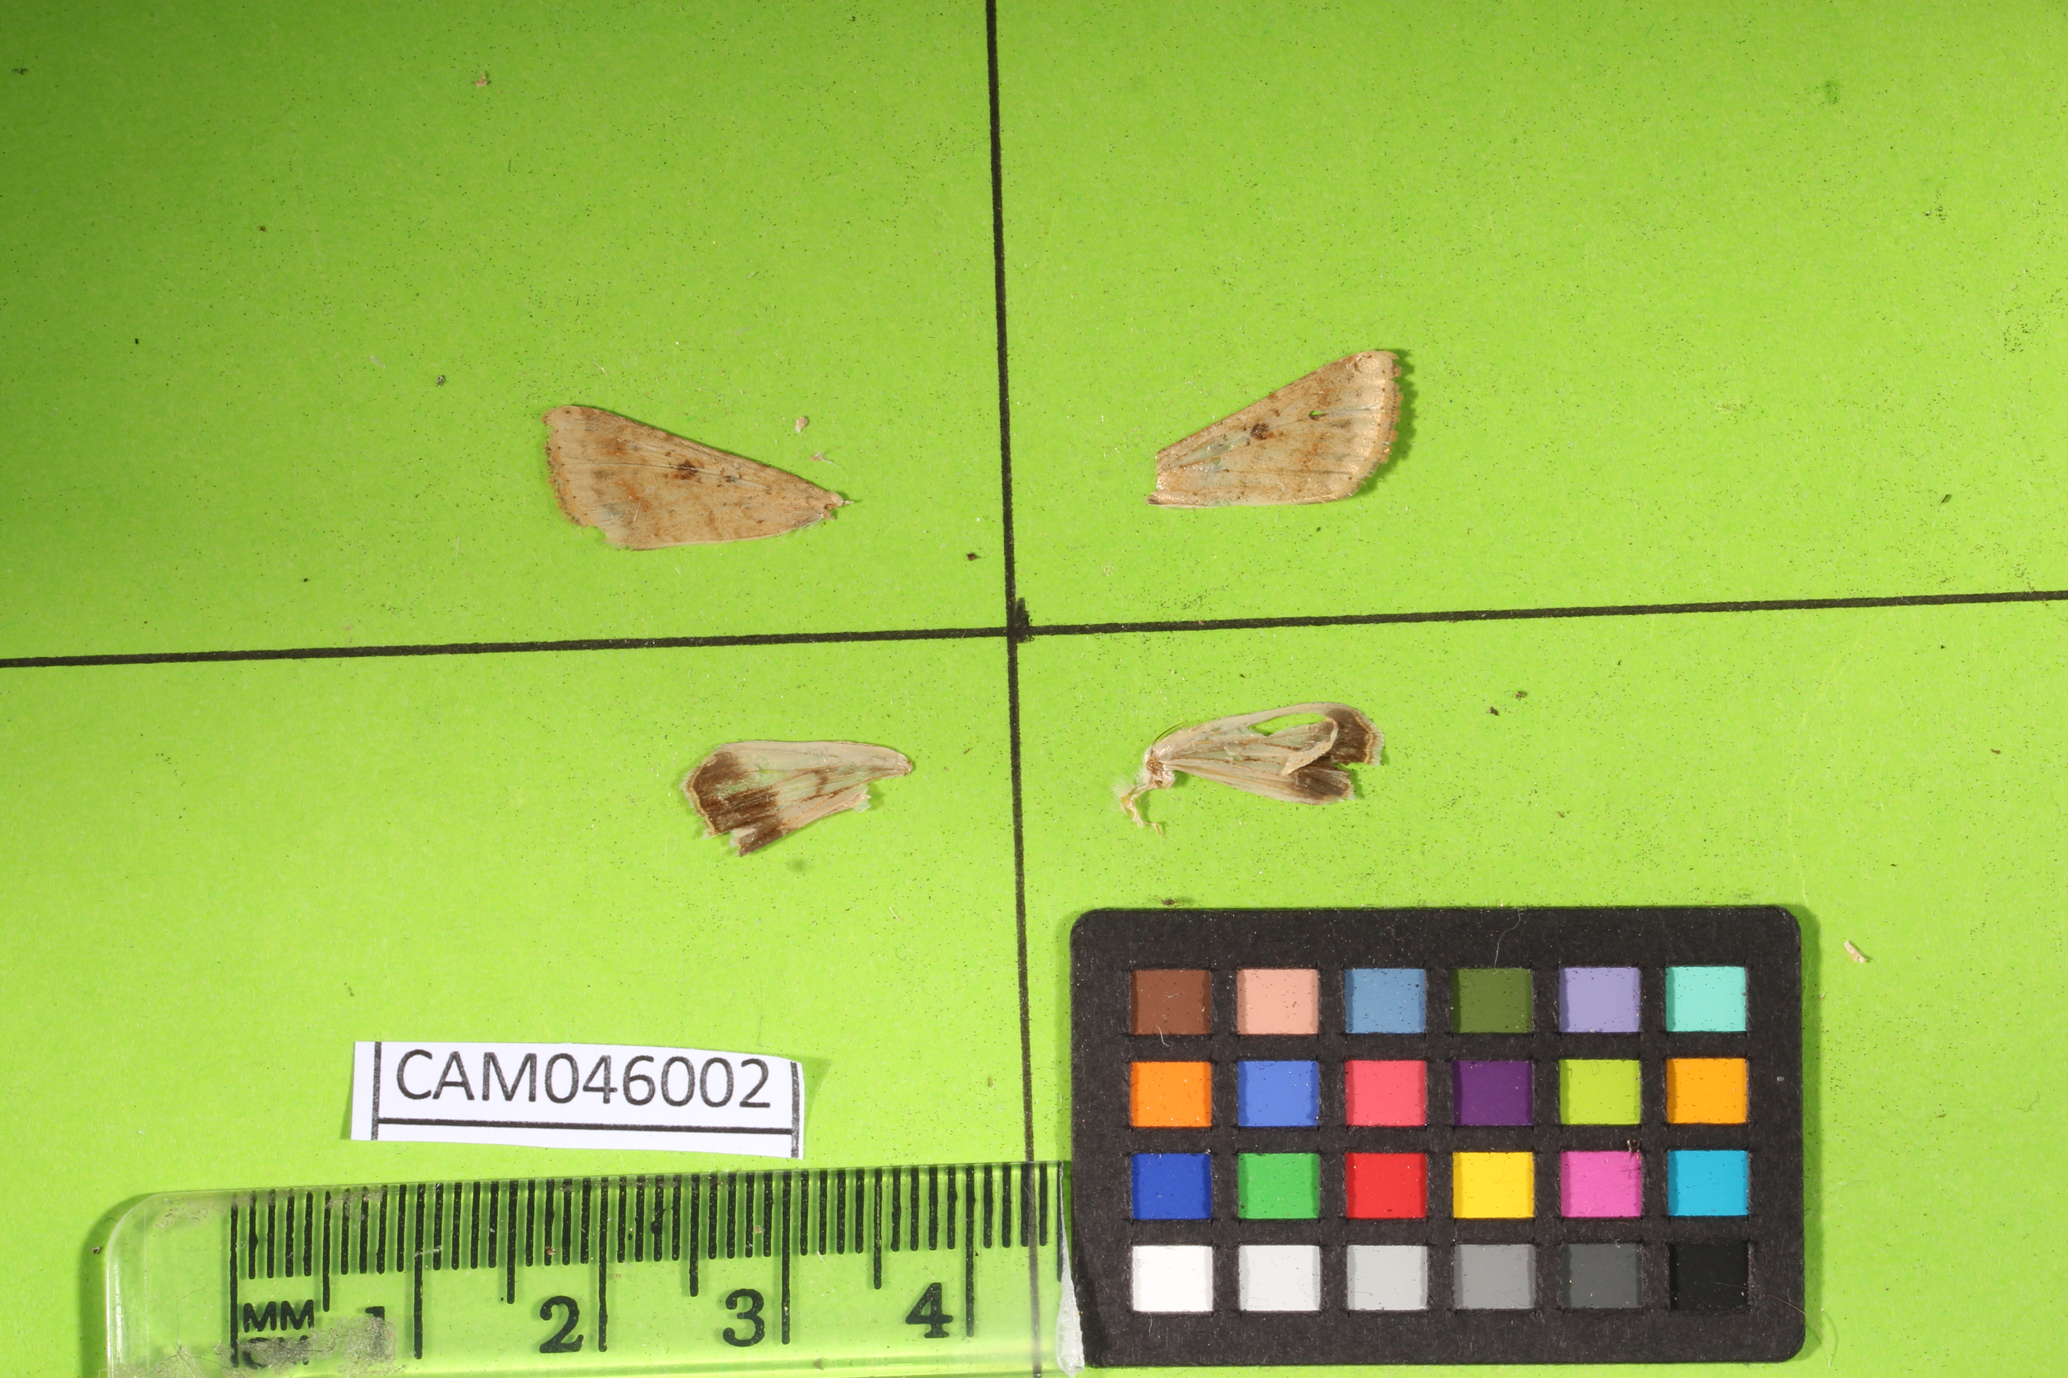
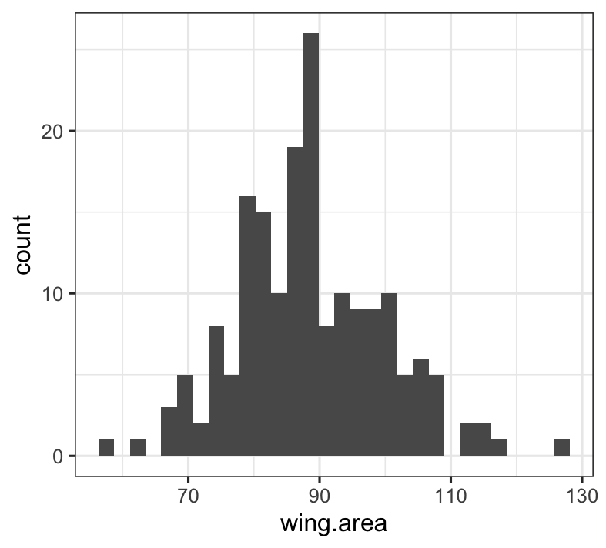
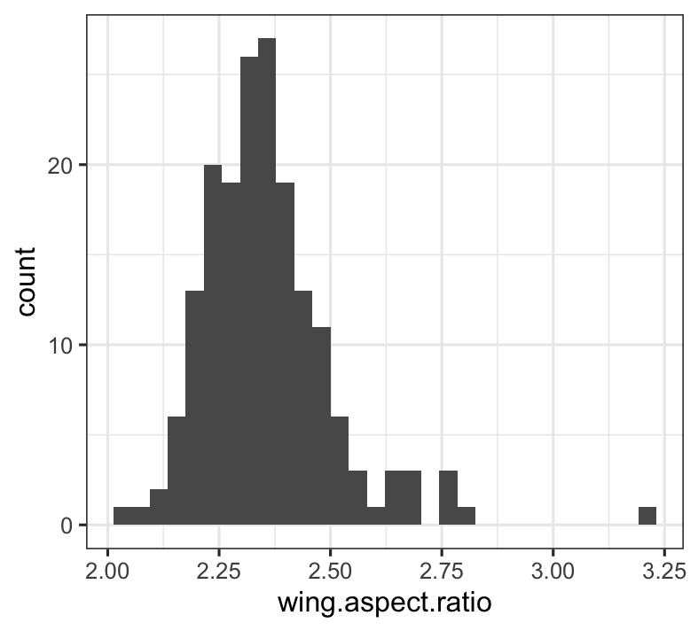
Wing dataset
Pulled wings of 402:
Benedict photographe, recovered wing size / shape ~200 indivs
Can we distinguish species/hybrids from wings?
Any temporal patterns? Fitness
Dispersal ability, wing shape

Slide 5
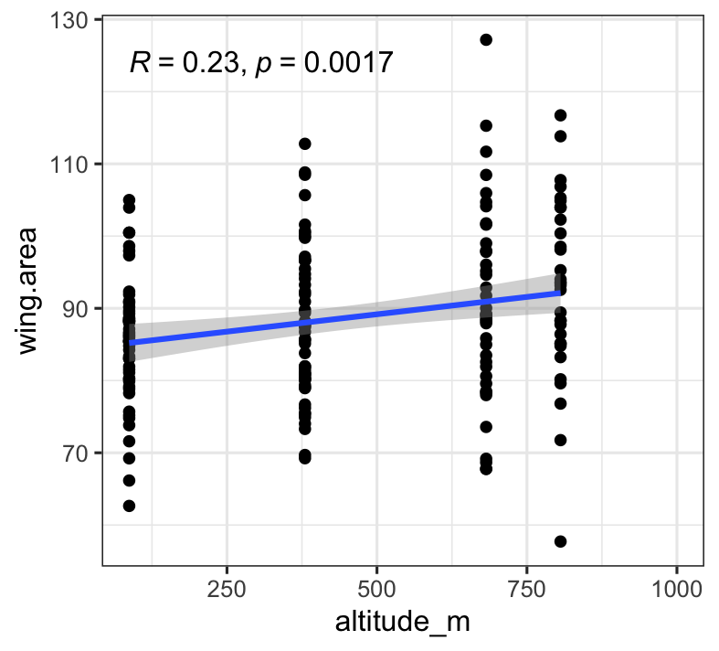
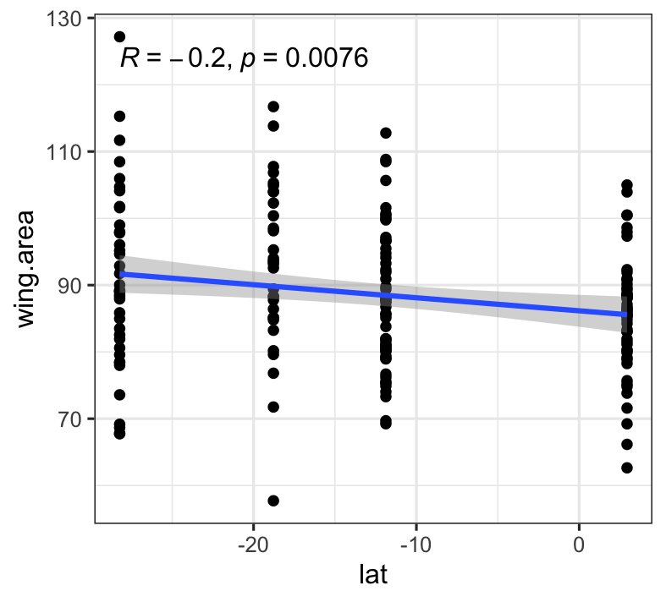
Bigger individuals at higher altitudes, smaller towards the equator

Slide 6
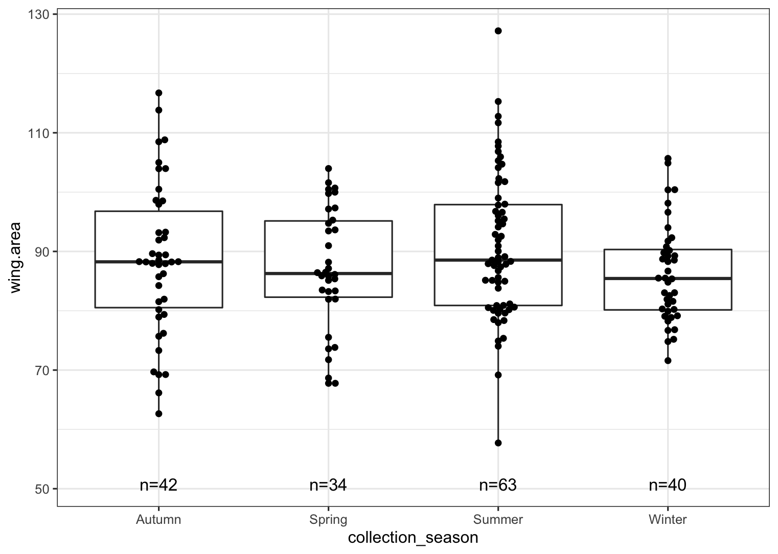
Winter (hot)- smaller indivs

Slide 7
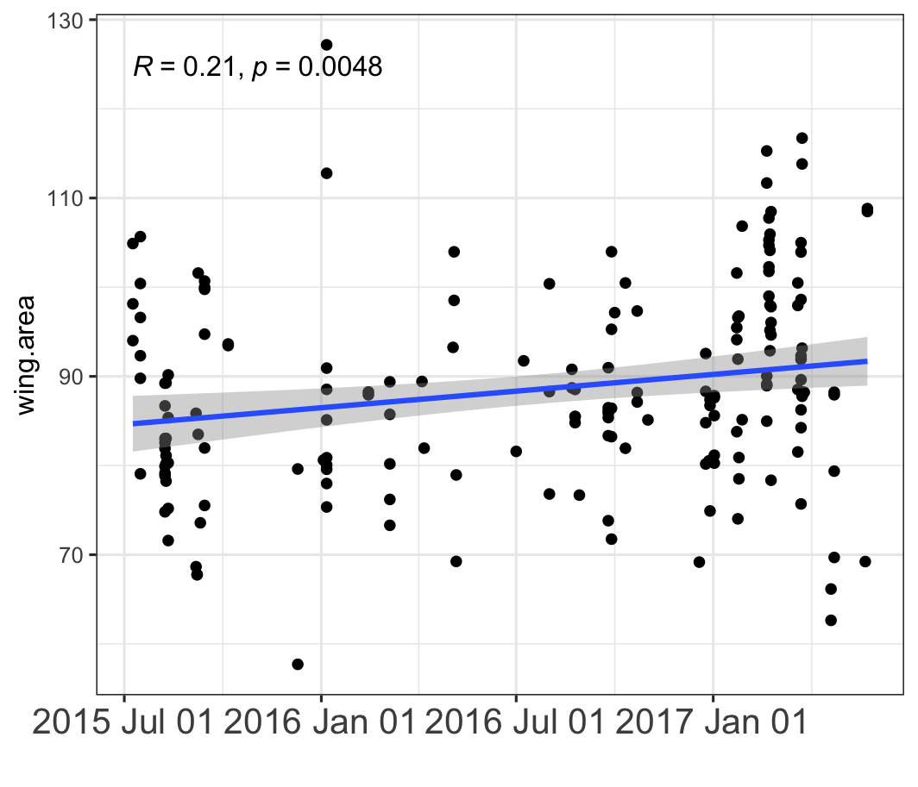
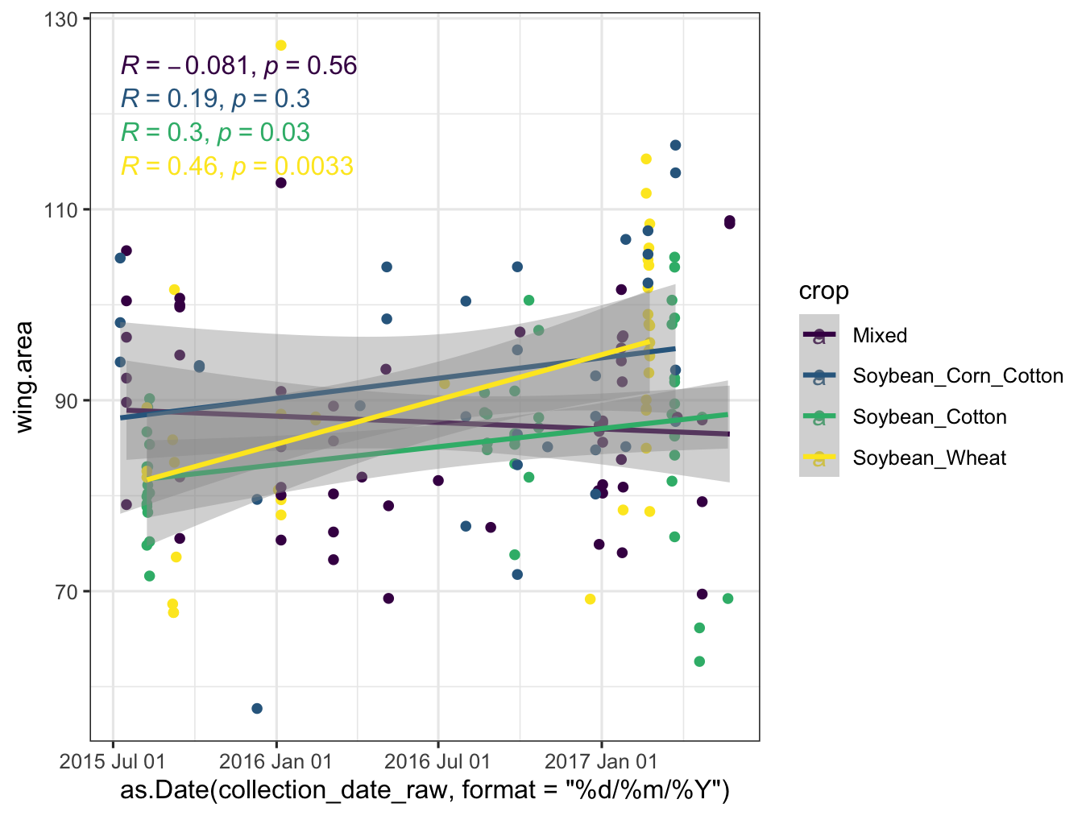
Bigger across years?

Slide 8
